Slide 1
Ch. 30
Money Growth and Inflation

Slide 2
Look for the answers to these questions:
How does the money supply affect inflation and nominal interest rates?
Does the money supply affect real variables like real GDP or the real interest rate?
How is inflation like a tax?
What are the costs of inflation? How serious are they?

Slide 3
Introduction
Prices rise when the government prints too much money.
Most economists believe the quantity theory is a good explanation of the long run behavior of inflation.

Slide 4
Inflation, Part 1
Inflation
Increase in the overall level of prices
Deflation
Decrease in the overall level of prices
Hyperinflation
Extraordinarily high rate of inflation
Inflation that exceeds 50% per month

Slide 5
Inflation, Part 2
2005 to 2015
Prices rose at an average rate of 1.2% per year
The 1970s
Prices rose by 7.8% per year
The price level more than doubled over the decade

Slide 6
Inflation, Part 3
International data, 2015, inflation rate
0.1% in the U.S
1.5% in China
4.9% in India
15% in Russia
84% in Venezuela
February 2008, Zimbabwe
24,000% (hyperinflation)

Slide 7

The Classical Theory of Inflation, Part 1
Classical theory of money
Quantity theory of money
Explain the long-run determinants of the price level
Explain the inflation rate
“So what’s it going to be? The same size as last year or the same price as last year?”

Slide 8
Level of Prices; Value of Money
Inflation
Economy-wide phenomenon
Concerns the value of economy’s medium of exchange
Inflation: rise in the price level
Lower value of money
Each dollar buys a smaller quantity of goods and services

Slide 9
The Classical Theory of Inflation, Part 2
Money demand
Reflects how much wealth people want to hold in liquid form
Depends on
Availability of ATM machines
Interest rate
Average level of prices in economy
Demand curve – downward sloping

Slide 10
The Value of Money
P = the price level (e.g., the CPI or GDP deflator)
P is the price of a basket of goods, measured in money.
1/P is the value of $1, measured in goods.
Example: basket contains one candy bar.
If P = $2, value of $1 is 1/2 candy bar
If P = $3, value of $1 is 1/3 candy bar
Inflation drives up prices and drives down the value of money.

Slide 11
The Quantity Theory of Money
Developed by 18th century philosopher David Hume and the classical economists.
Advocated more recently by Nobel Prize Laureate Milton Friedman.
Asserts that the quantity of money determines the value of money
We study this theory using two approaches:
A supply-demand diagram
An equation

Slide 12
Money Supply (MS)
Money supply in the real world
Determined by the Fed, the banking system, and consumers.
Money supply in this model
We assume the Fed precisely controls MS and sets it at some fixed amount.

Slide 13
Money Demand (MD)
Money demand
Refers to how much wealth people want to hold in liquid form.
Depends on P: an increase in P reduces the value of money, so more money is required to buy goods and services.
Quantity of money demanded
Is negatively related to the value of money
And positively related to P, other things equal.

Slide 14
The Money Supply-Demand Diagram
0
Value of Money, 1/P
Price Level, P
As the value of money rises, the price level falls.
1
1
¾
1.33
½
2
¼
4
Quantity of Money
Notes:
14

Slide 15
The Money Supply-Demand Diagram
0
Value of Money, 1/P
Price Level, P
MS₁
1
1
¾
1.33
The Fed sets MS at some fixed value, regardless of P.
½
2
¼
4
$1000
Quantity of Money
Notes:
15

Slide 16
The Money Supply-Demand Diagram
0
Value of Money, 1/P
A fall in value of money (or increase in P) increases the quantity of money demanded:
Price Level, P
1
1
¾
1.33
½
2
¼
4
MD₁
Quantity of Money
Notes:
16

Slide 17
The Money Supply-Demand Diagram
0
Value of Money, 1/P
P adjusts to equate quantity of money demanded with money supply.
Price Level, P
MS₁
1
1
¾
1.33
eq’m value of money
eq’m price level
A
½
2
¼
4
MD₁
$1000
Quantity of Money
Notes:
17
Eq’m = equilibrium

Slide 18
The Effects of a Monetary Injection
0
Value of Money, 1/P
Price Level, P
MS₁
MS₂
Suppose the Fed increases the money supply.
1
1
Then the value of money falls, and P rises.
¾
1.33
A
½
2
eq’m value of money
eq’m price level
B
¼
4
MD₁
$1000
$2000
Quantity of Money
Notes:
18

Slide 19
A Brief Look at the Adjustment Process
From graph: Increasing MS causes P to rise.
How does this work? Short version:
At the initial P, an increase in MS causes an excess supply of money.
People get rid of their excess money by spending it on goods and services or by loaning it to others, who spend it. Result: increased demand for goods.
But supply of goods does not increase, so prices must rise.

Slide 20
Effects of a Monetary Injection, Part 1
Economy is in equilibrium
If the Fed doubles the supply of money
Prints bills
Drops them on market
Or the Fed: open-market purchase
New equilibrium
Supply curve shifts right
Value of money decreases
Price level increases

Slide 21
Effects of a Monetary Injection, Part 2
Quantity theory of money
The quantity of money available in the economy determines (the value of money) the price level
Growth rate in quantity of money available determines the inflation rate

Slide 22
Classical Dichotomy, Part 1
Nominal variables
Variables measured in monetary units
Dollar prices
Real variables
Variables measured in physical units
Relative prices, real wages, real interest rate
Classical dichotomy
Theoretical separation of nominal and real variables

Slide 23
Real vs. Nominal Variables
Prices are normally measured in terms of money:
Price of a compact disc: $15/cd
Price of a pepperoni pizza: $10/pizza
A relative price
Is the price of one good relative to (divided by) another
Relative price of CDs in terms of pizza:
price of cd
$15/cd
=
= 1.5 pizzas per cd
price of pizza
$10/pizza
Notes:
Relative prices are measured in physical units, so they are real variables.

Slide 24
Real vs. Nominal Wage
An important relative price is the real wage:
W = nominal wage = price of labor, e.g., $15/hour
P = price level = price of goods and services, e.g., $5/unit of output
Real wage
Is the price of labor relative to the price of output:
W
$15/hour
=
= 3 units output per hour
P
$5/unit of output

Slide 25
The Classical Dichotomy
Classical dichotomy:
Theoretical separation of nominal and real variables
Hume and the classical economists: monetary developments affect nominal variables but not real variables:
If central bank doubles the money supply:
Then all nominal variables—including prices—will double
But all real variables—including relative prices—will remain unchanged.

Slide 26
The Neutrality of Money
Monetary neutrality:
The proposition that changes in the money supply do not affect real variables
Doubling money supply
Causes all nominal prices to double
What happens to relative prices?

Slide 27
The Neutrality of Money
Initially, relative price of cd in terms of pizza is
price of cd
$15/cd
=
= 1.5 pizzas per cd
price of pizza
$10/pizza
The relative price is unchanged.
After nominal prices double,
price of cd
$30/cd
=
= 1.5 pizzas per cd
price of pizza
$20/pizza
Notes:
This result is important because relative prices, not nominal prices, determine the economy’s allocation of resources.

Slide 28
The Neutrality of Money
Similarly, the real wage W/P remains unchanged, so
Quantity of labor supplied does not change
Quantity of labor demanded does not change
Total employment of labor does not change
The same applies to employment of capital and other resources.
Since employment of all resources is unchanged, total output is also unchanged by the money supply.
Notes:
Monetary neutrality: the proposition that changes in the money supply do not affect real variables.
The material on this slide does not appear explicitly in this chapter, but it helps explain how money can be neutral.

Slide 29
The Neutrality of Money
Most economists believe
The classical dichotomy and neutrality of money describe the economy in the long run.

Slide 30
The Velocity of Money
Velocity of money:
The rate at which money changes hands
The number of transaction in which the average dollar is used
Notation:
P x Y= nominal GDP = (price level) x (real GDP)
M = money supply
V = velocity
Velocity formula:
P x Y
V =
M

Slide 31
The Velocity of Money
Velocity formula V = P x Y / M
Example with one good: pizza. In 2015:
Y = real GDP = 3000 pizzas
P = price level = price of pizza = $10
P x Y= nominal GDP = value of pizzas = $30,000
M = money supply = $10,000
V = velocity = $30,000/$10,000 = 3
The average dollar was used in 3 transactions.
Notes:
If $10,000 worth of money purchases $30,000 worth of pizza, it must be true that the average dollar is used three times.

Slide 32
Active Learning 1 Velocity of money
One good: corn.
The economy has enough labor, capital, and land to produce Y = 800 bushels of corn.
V is constant.
In 2014, MS = $2000, P = $5/bushel.
Compute nominal GDP and velocity in 2014.
Nominal GDP =
Velocity V =

Slide 33
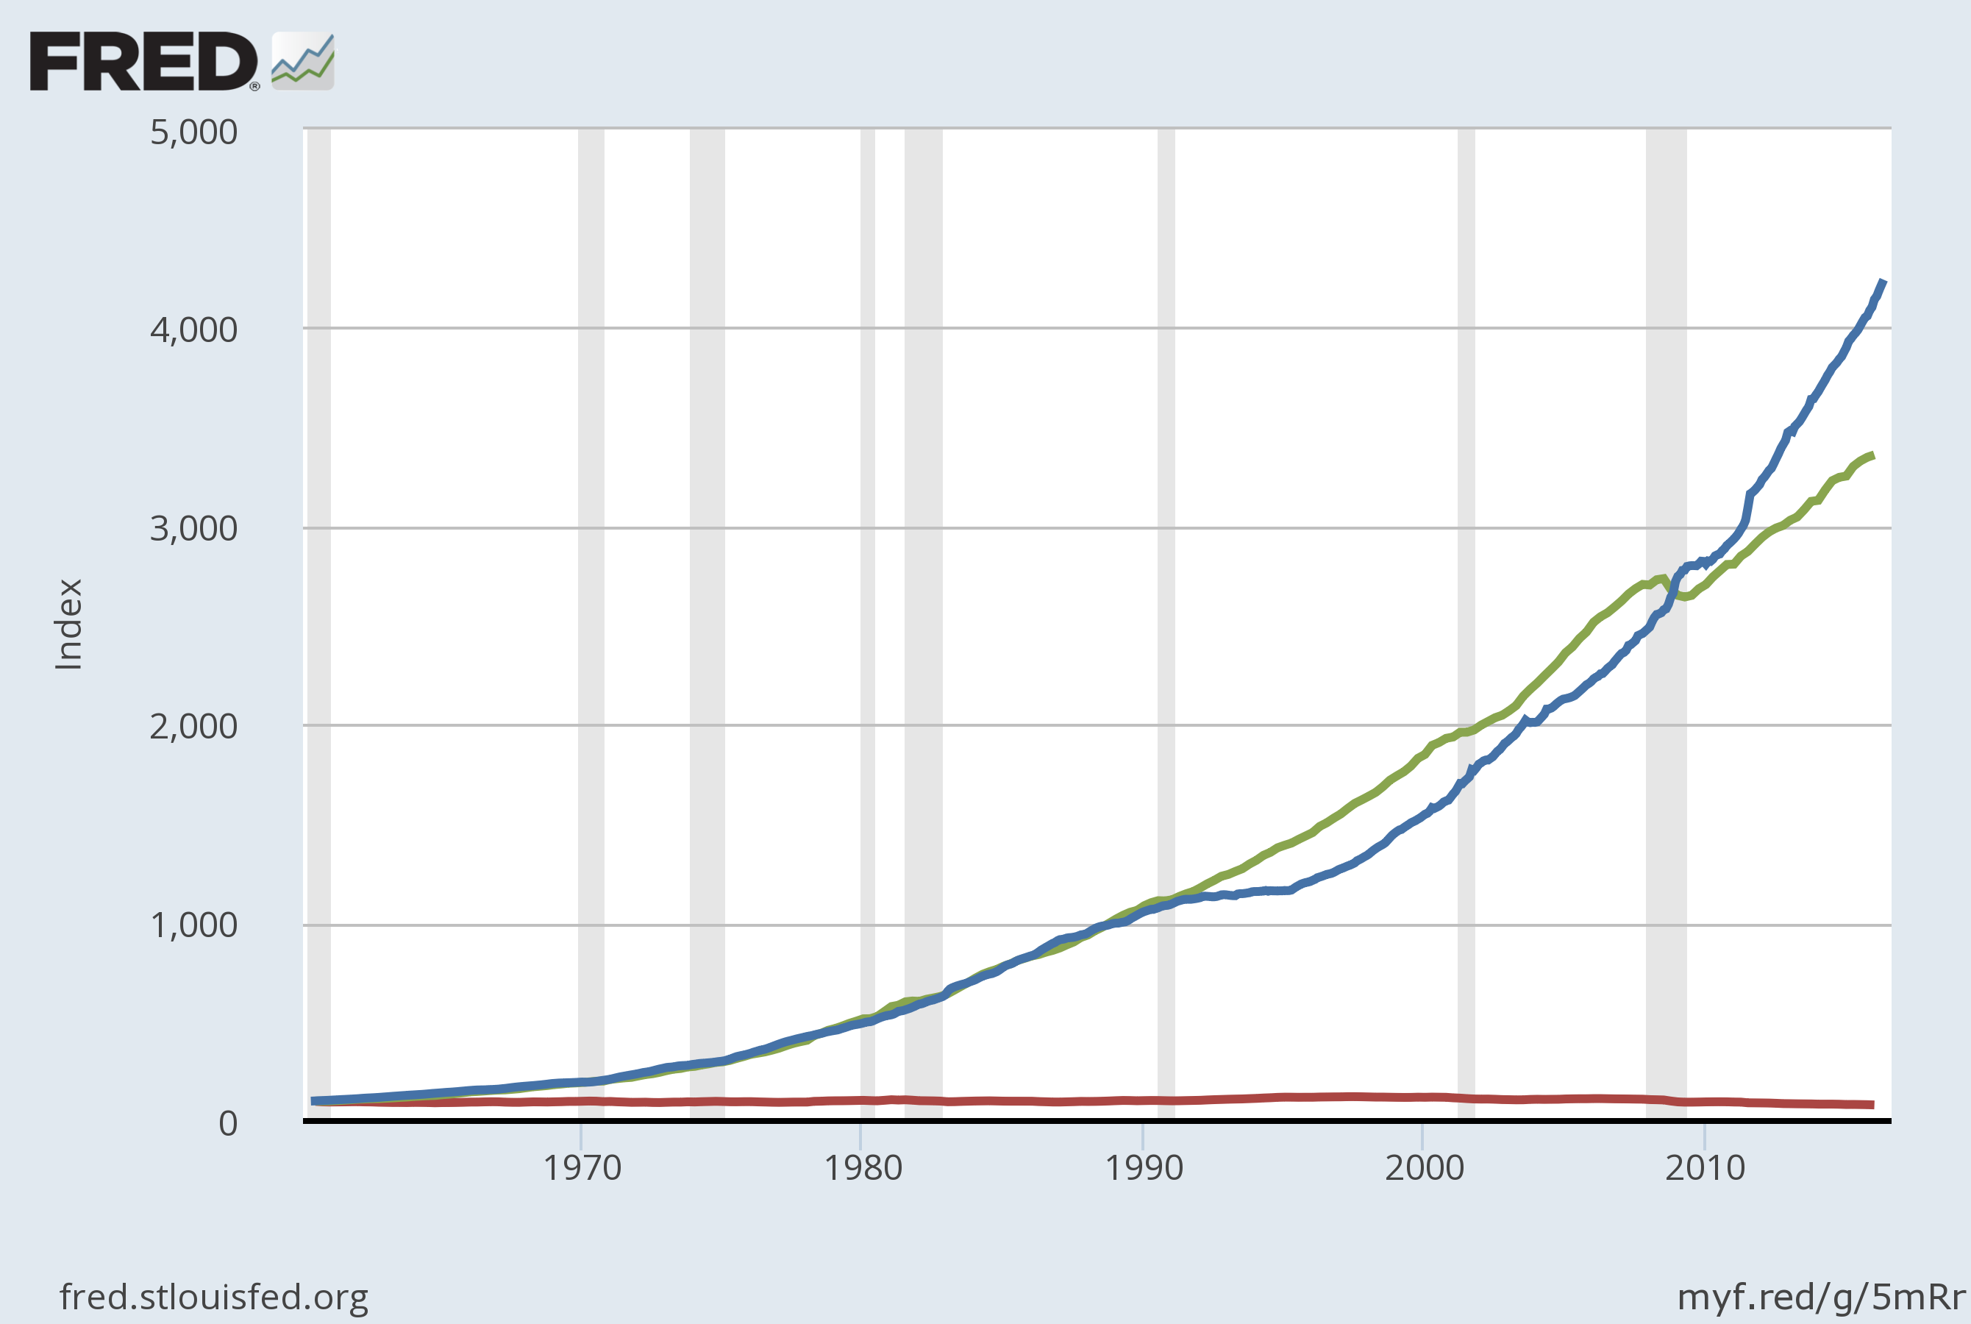
U.S. Nominal GDP, M2, and Velocity 1960–2016
Velocity is fairly stable over the long run.
Nominal GDP
M2
1960=100
Velocity
Notes:
Note: Each variable has been scaled to equal 100 to make variables comparable.
Original sources:
M2 is from Board of Governors, Federal Reserve Board
GDP is from U.S. Department of Commerce, Bureau of Economic Analysis.
I obtained all data from FRED database, Federal Reserve Bank of St. Louis, at:
http://research.stlouisfed.org/fred2/
Board of Governors of the Federal Reserve System (US), M2 Money Stock [M2], retrieved from FRED, Federal Reserve Bank of St. Louis; https://fred.stlouisfed.org/series/M2, July 11, 2016.
Federal Reserve Bank of St. Louis, Velocity of M2 Money Stock [M2V], retrieved from FRED, Federal Reserve Bank of St. Louis; https://fred.stlouisfed.org/series/M2V, July 11, 2016.
US. Bureau of Economic Analysis, Gross Domestic Product [GDP], retrieved from FRED, Federal Reserve Bank of St. Louis; https://fred.stlouisfed.org/series/GDP, July 11, 2016.

Slide 34
The Quantity Theory
The quantity equation: M x V = P x Y
V is stable.
A change in M causes nominal GDP (P x Y) to change by the same percentage.
A change in M does not affect Y: money is neutral, Y is determined by technology & resources
So, P changes by same percentage as P x Y and M.
Rapid money supply growth causes rapid inflation.
Notes:
Velocity V = P x Y / M

Slide 35
Active Learning 2 Quantity Theory of Money
One good: corn.
The economy has enough labor, capital, and land to produce Y = 800 bushels of corn. V is constant.
In 2014, MS = $2000, P = $5/bushel.
For 2015, the Fed increases MS by 5%, to $2100.
Compute the 2015 values of nominal GDP and P. Compute the inflation rate for 2014–2015.
Suppose tech. progress causes Y to increase to 824 in 2015. Compute 2014–2015 inflation rate.

Slide 36
Lessons about the quantity theory of money The quantity equation: M x V = P x Y
Assume V is relatively stable over time,
If real GDP (Y) is constant,
Then inflation rate = money growth rate.
If real GDP is growing,
Then inflation rate < money growth rate.
The bottom line:
Excessive money growth causes inflation.
Money growth doesn’t affect Y (real GDP) growth.
Y primarily determined by factor supplies and available production technology.
Notes:
F

Slide 37
The Inflation Tax
The inflation tax
Revenue the government raises by creating (printing) money
No on receives a a bill from the government from this tax
The inflation tax causes hyperinflation in some countries.
Notes:
When tax revenue is inadequate and ability to borrow is limited, government may print money to pay for its spending.
Almost all hyperinflations start this way.
The revenue from printing money is the inflation tax: printing money causes inflation, which is like a tax on everyone who holds money.

Slide 38
The Inflation Tax
The inflation tax
When the government prints money
The price level rises
And the dollars in your wallet are less valuable
In the U.S., the inflation tax today accounts for less than 3% of total revenue
Notes:
When tax revenue is inadequate and ability to borrow is limited, government may print money to pay for its spending.
Almost all hyperinflations start this way.
The revenue from printing money is the inflation tax: printing money causes inflation, which is like a tax on everyone who holds money.

Slide 39
The Fisher Effect
Principle of monetary neutrality
An increase in the rate of money growth
Raises the rate of inflation
But does not affect any real variable
Effect of money on interest rates:
Real interest rate = Nominal interest rate – Inflation rate
We get
Nominal interest rate = Real interest rate + Inflation rate
Notes:
The real interest rate is determined by saving & investment in the loanable funds market.
Money supply growth determines inflation rate.
Rearranging the definition of the real interest rate we get Nominal interest rate.

Slide 40
The Fisher Effect
Fisher effect
One-for-one adjustment of nominal interest rate to inflation rate
When the Fed increases the rate of money growth
Higher inflation rate
Higher nominal interest rate
(In the long run result)
Notes:
In the long run, money is neutral: a change in the money growth rate affects the inflation rate but not the real interest rate.
So, the nominal interest rate adjusts one-for-one with changes in the inflation rate:
Nominal interest rate = Real interest rate + Inflation rate. This relationship is called the Fisher effect after Irving Fisher, who studied it.
The inflation tax applies to people’s holdings of money, not their holdings of wealth.
The Fisher effect: an increase in inflation causes an equal increase in the nominal interest rate, so the real interest rate (on wealth) is unchanged.

Slide 41
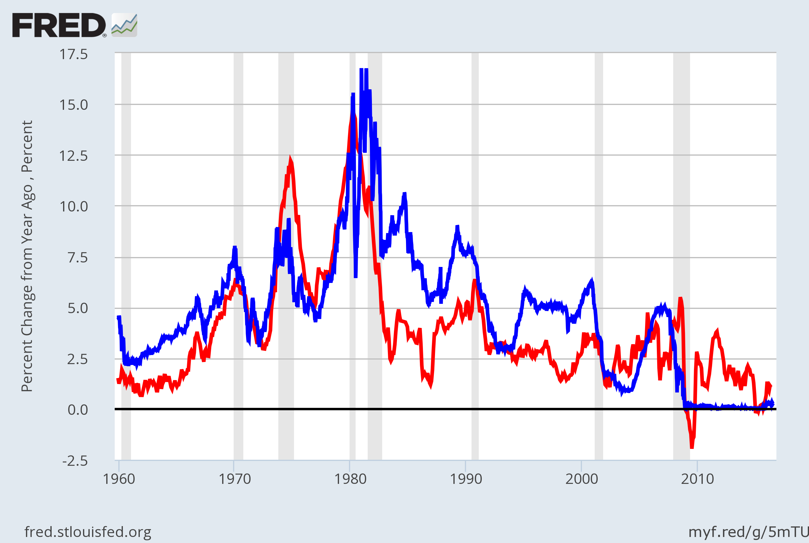
U.S. Nominal Interest & Inflation Rates, 1960–2016
The close relation between these variables is evidence for the Fisher effect.
Nominal interest rate
Inflation rate
Notes:
The nominal interest rate is the 3-month Treasury Bill rate. The inflation rate is calculated as the percent change in the CPI from 12 months earlier.
Mostly, these two variables move very closely together: increases in inflation correspond to similar increases in the nominal interest rate.
When the two variables are not moving precisely together, the real interest rate is changing. This would occur if, for example, there were changes in the supply and/or demand for loanable funds. Starting in the early 1980s, the emergence of huge budget deficits caused the supply of loanable funds to fall, which increased the real interest rate. On this graph, the gap between the nominal interest rate and inflation rate clearly grows in the early 1980s.
Original sources:
CPI, not seasonally adjusted: Bureau of Labor Statistics, U.S. Department of Labor
Treasury Bill rate: Board of Governors of the Federal Reserve System
Where I obtained this data:
FRED database, Federal Reserve Bank of St. Louis
http://research.stlouisfed.org/fred2/
US. Bureau of Labor Statistics, Consumer Price Index for All Urban Consumers: All Items [CPIAUCSL], retrieved from FRED, Federal Reserve Bank of St. Louis; https://fred.stlouisfed.org/series/CPIAUCSL, July 11, 2016.
Board of Governors of the Federal Reserve System (US), 3-Month Treasury Bill: Secondary Market Rate [WTB3MS], retrieved from FRED, Federal Reserve Bank of St. Louis; https://fred.stlouisfed.org/series/WTB3MS, July 11, 2016.

Slide 42
The Costs of Inflation
Inflation fallacy
“Inflation robs people of the purchasing power of his hard-earned dollars”
When prices rise
Buyers pay more
Sellers get more
Inflation does not in itself reduce people’s real purchasing power
Notes:
Inflation is a general increase in prices of the things people buy and the things they sell (e.g., their labor).
In the long run, real incomes are determined by real variables, not the inflation rate.

Slide 43
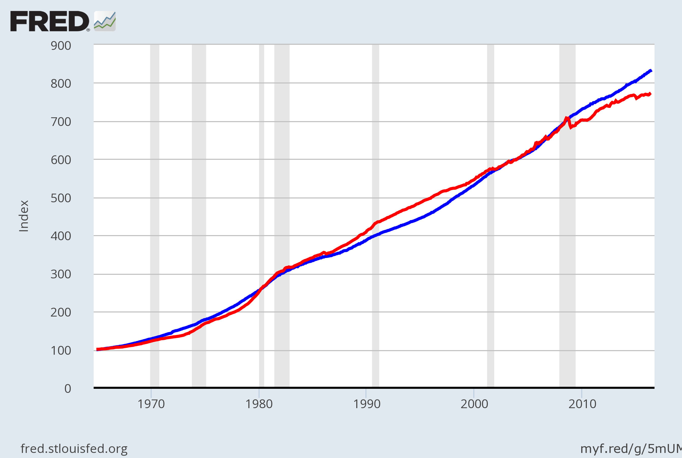
U.S. Average Hourly Earnings & the CPI 1965 - 2016
Inflation causes the CPI and nominal wages to rise together over the long run.
Nominal wage
CPI
Notes:
This graph is not in the textbook, but it helps expose the inflation fallacy.
Both series are normalized to equal 100 in December 1964. The graph shows that the cost of living has risen dramatically since 1965—but the nominal wage has kept up with inflation. If the inflation fallacy were true, the nominal wage would have risen at a slower rate than the CPI.
Source: The nominal wage is average hourly earnings, total for private sector, seasonally adjusted, from the Bureau of Labor Statistics, U.S. Department of Labor. The CPI in this graph is seasonally adjusted, also from the BLS.
US. Bureau of Labor Statistics, Average Hourly Earnings of Production and Nonsupervisory Employees: Total Private [AHETPI], retrieved from FRED, Federal Reserve Bank of St. Louis; https://fred.stlouisfed.org/series/AHETPI, July 11, 2016.
US. Bureau of Labor Statistics, Consumer Price Index for All Urban Consumers: All Items [CPIAUCSL], retrieved from FRED, Federal Reserve Bank of St. Louis; https://fred.stlouisfed.org/series/CPIAUCSL, July 11, 2016.

Slide 44
The Costs of Inflation
Shoeleather costs
Resources wasted when inflation encourages people to reduce their money holdings
Can be substantial
Menu costs
Costs of changing prices
Inflation – increases menu costs that firms must bear
Notes:
Shoeleather costs: includes the time and transactions costs of more frequent bank withdrawals
Menu costs: printing new menus, mailing new catalogs, etc.

Slide 45
The Costs of Inflation
Misallocation of resources from relative-price variability:
Firms don’t all raise prices at the same time, so relative prices can vary
Distorts the allocation of resources
Confusion and inconvenience:
Inflation changes the yardstick we use to measure transactions
Complicates long-range planning and the comparison of dollar amounts over time

Slide 46
The Costs of Inflation
Tax distortions:
Inflation makes nominal income grow faster than real income.
Taxes are based on nominal income, and some are not adjusted for inflation.
So, inflation causes people to pay more taxes even when their real incomes don’t increase.

Slide 47
The Costs of Inflation
All these costs
Are quite high for economies experiencing hyperinflation.
For economies with low inflation (< 10% per year),
These costs are probably much smaller, though their exact size is open to debate.

Slide 48
Active Learning 3 Tax distortions
You deposit $1000 in the bank for one year.
CASE 1: inflation = 0%, nom. interest rate = 10%
CASE 2: inflation = 10%, nom. interest rate = 20%
In which case does the real value of your deposit grow the most?
Assume the tax rate is 25%.
In which case do you pay the most taxes?
Compute the after-tax nominal interest rate, then subtract inflation to get the after-tax real interest rate for both cases.
Notes:
Most principles-level students have difficulty the first time they are asked to calculate the after-tax real interest rate because the calculation involves several intermediate steps. The intermediate steps are, at first, not obvious to most students. This exercise walks students through these steps.
The exercise leads students to see for themselves that inflation reduces the after-tax real interest rate.
Suggestion: Display this slide, and give students 3-4 minutes to work the problem on their own.

Slide 49
Active Learning 3 Summary and lessons
Deposit $1000. Tax rate =25%.
CASE 1: inflation = 0%, nom. interest rate = 10%
CASE 2: inflation = 10%, nom. interest rate = 20%
Inflation…
raises nominal interest rates (Fisher effect) but not real interest rates
increases savers’ tax burdens
lowers the after-tax real interest rate
Notes:
By lowering the after-tax interest rate, inflation reduces the incentive to save. Recall that saving is critically important for future productivity and living standards.

Slide 50
Arbitrary Redistributions of Wealth
Unexpected inflation
Redistributes wealth among the population
Not by merit
Not by need
Redistribute wealth among debtors and creditors
Inflation: volatile and uncertain
When the average rate of inflation is high
Notes:
For many students, this is one of the harder concepts of the chapter. You might consider asking students to work through Problem 10 in the “Problems and Applications” at the end of this chapter for practice with this concept.
Higher-than-expected inflation transfers purchasing power from creditors to debtors: Debtors get to repay their debt with dollars that aren’t worth as much.
Lower-than-expected inflation transfers purchasing power from debtors to creditors.
High inflation is more variable and less predictable than low inflation. So, these arbitrary redistributions are frequent when inflation is high.

Slide 51
Conclusion
Prices rise when the government prints too much money.
We saw that money is neutral in the long run, affecting only nominal variables
In later chapters
Money has important effects in the short run on real variables like output and employment
Notes:
The first sentence is one of the Ten Principles.

Slide 52
Summary
To explain inflation in the long run, economists use the quantity theory of money.
The price level depends on the quantity of money, and the inflation rate depends on the money growth rate.
The classical dichotomy is the division of variables into real and nominal. The neutrality of money is the idea that changes in the money supply affect nominal variables but not real ones. Most economists believe these ideas describe the economy in the long run.

Slide 53
Summary
The inflation tax is the loss in the real value of people’s money holdings when the government causes inflation by printing money.
The Fisher effect is the one-for-one relation between changes in the inflation rate and changes in the nominal interest rate.
The costs of inflation include menu costs, shoeleather costs, confusion and inconvenience, distortions in relative prices and the allocation of resources, tax distortions, and arbitrary redistributions of wealth.

